Slide 1
Generalising Finite Difference Methods and dealing with time
PHYS3112 – Tutorial 6

Slide 2
Today we will:
Generalising the 1d Poisson equation to work with 2 different materials
Generalising the 1d Poisson equation to 2D
Solving the heat equation by stepping forward in time
Solving the heat equation using Crank-Nicholson method
Basically, a whole lot of matrix manipulation in python

Slide 3
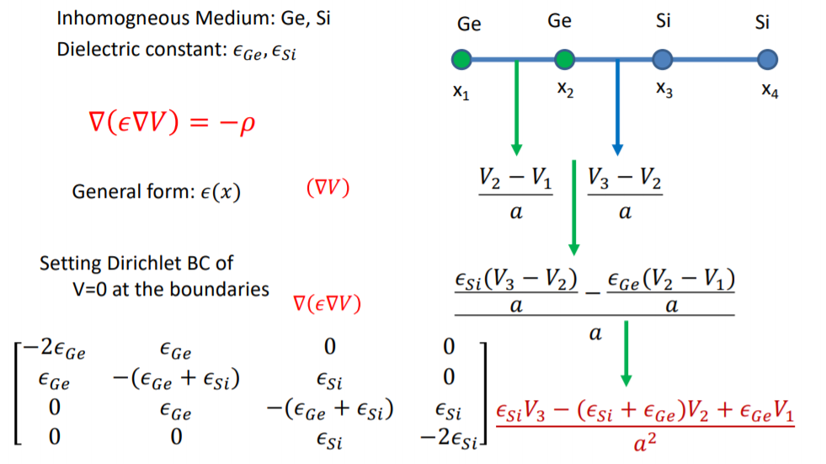
Inhomogeneous Poisson

Slide 4


Inhomogeneous Poisson
ε₀
x₀
ε₀
x₁
ε₀
x₂
ε₁
x₃
ε₁
x₄
$\left[\begin{matrix}−2ε_{0} & ε_{0} & 0 & 0 & 0 \\ ε_{0} & −2ε_{0} & ε_{0} & 0 & 0 \\ 0 & ε_{0} & −(ε_{0}+ε_{1}) & ε_{1} & 0 \\ 0 & 0 & ε_{0} & −(ε_{0}+ε_{1}) & ε_{1} \\ 0 & 0 & 0 & ε_{1} & −2ε_{1}\end{matrix}\right]$ =
$$ε_{0} \left[\begin{matrix}−2 & 1 & 0 & 0 & 0 \\ 1 & −2 & 1 & 0 & 0 \\ 0 & 1 & −1 & 0 & 0 \\ 0 & 0 & 1 & −1 & 0 \\ 0 & 0 & 0 & 0 & 0\end{matrix}\right]+ε_{1}\left[\begin{matrix}0 & 0 & 0 & 0 & 0 \\ 0 & 0 & 0 & 0 & 0 \\ 0 & 0 & −1 & 1 & 0 \\ 0 & 0 & 0 & −1 & 1 \\ 0 & 0 & 0 & 1 & −2\end{matrix}\right]$$

Slide 5
Inhomogeneous Poisson
ε₀
x₀
ε₀
x₁
ε₀
x₂
ε₁
x₃
ε₁
x₄
$\left[\begin{matrix}−2ε_{0} & ε_{0} & 0 & 0 & 0 \\ ε_{0} & −2ε_{0} & ε_{0} & 0 & 0 \\ 0 & ε_{0} & −(ε_{0}+ε_{1}) & ε_{1} & 0 \\ 0 & 0 & ε_{0} & −(ε_{0}+ε_{1}) & ε_{1} \\ 0 & 0 & 0 & ε_{1} & −2ε_{1}\end{matrix}\right]$ =
$$ε_{0} \left[\begin{matrix}−2 & 1 & 0 & 0 & 0 \\ 1 & −2 & 1 & 0 & 0 \\ 0 & 1 & −1 & 0 & 0 \\ 0 & 0 & 1 & −1 & 0 \\ 0 & 0 & 0 & 0 & 0\end{matrix}\right]+ε_{1}\left[\begin{matrix}0 & 0 & 0 & 0 & 0 \\ 0 & 0 & 0 & 0 & 0 \\ 0 & 0 & −1 & 1 & 0 \\ 0 & 0 & 0 & −1 & 1 \\ 0 & 0 & 0 & 1 & −2\end{matrix}\right]$$

Slide 6


Inhomogeneous Poisson
ε₀
x₀
ε₀
x₁
ε₀
x₂
ε₁
x₃
ε₁
x₄
$$\left[\begin{matrix}−2 & 1 & 0 & 0 \\ 1 & −2 & 1 & 0 \\ 0 & 1 & −1 & 0 \\ 0 & 0 & 1 & −1\end{matrix}\right]=TriDiag_{4x4}+\left[\begin{matrix}0 & 0 & 0 & 0 \\ 0 & 0 & 0 & 0 \\ 0 & 0 & 1 & −1 \\ 0 & 0 & 0 & 1\end{matrix}\right]$$
$$\left[\begin{matrix}−1 & 1 & 0 \\ 0 & −1 & 1 \\ 0 & 1 & −2\end{matrix}\right]=TriDiag_{3x3}+\left[\begin{matrix}1 & 0 & 0 \\ −1 & 1 & 0 \\ 0 & 0 & 0\end{matrix}\right]$$

Slide 7
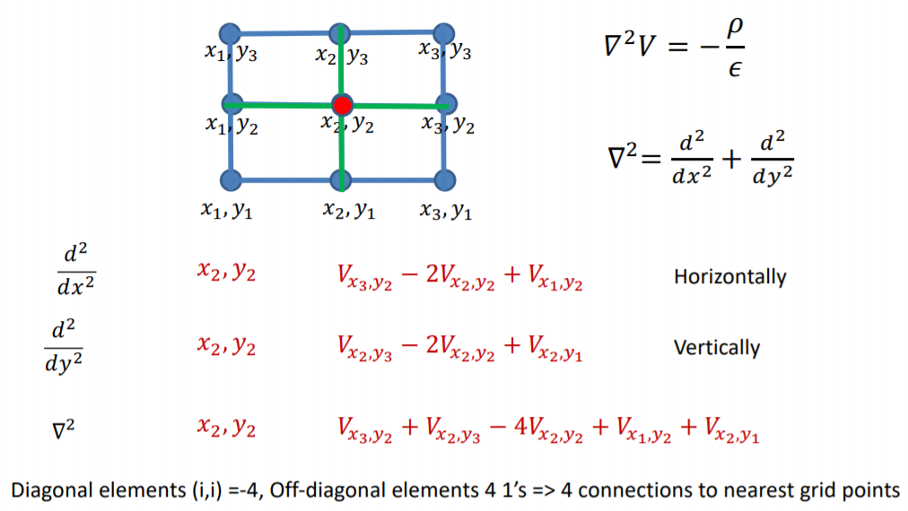
2D Poisson

Slide 8
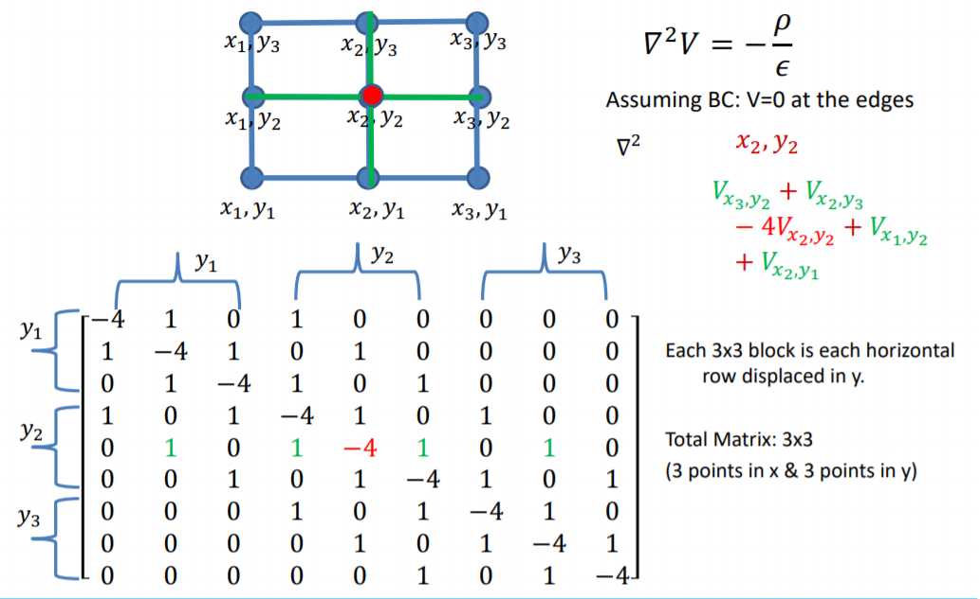
2D Poisson
x₁
x₂
x₃
x₁
x₂
x₃
x₁
x₂
x₃

Slide 9

2D Poisson – mesh grids
$$x_{mesh}=\left[\begin{matrix}0 & 1 & 2 & 3 & 4 \\ 0 & 1 & 2 & 3 & 4 \\ 0 & 1 & 2 & 3 & 4 \\ 0 & 1 & 2 & 3 & 4 \\ 0 & 1 & 2 & 3 & 4\end{matrix}\right]$$
$$y_{mesh}=\left[\begin{matrix}0 & 0 & 0 & 0 & 0 \\ 1 & 1 & 1 & 1 & 1 \\ 2 & 2 & 2 & 2 & 2 \\ 3 & 3 & 3 & 3 & 3 \\ 4 & 4 & 4 & 4 & 4\end{matrix}\right]$$
$$ρ=\left[\begin{matrix}0 & 1 & 2 & 3 & 4 \\ 0 & 1 & 2 & 3 & 4 \\ 0 & 1 & 2 & 3 & 4 \\ 0 & 1 & 2 & 3 & 4 \\ 0 & 1 & 2 & 3 & 4\end{matrix}\right]+\left[\begin{matrix}0 & 0 & 0 & 0 & 0 \\ 1 & 1 & 1 & 1 & 1 \\ 2 & 2 & 2 & 2 & 2 \\ 3 & 3 & 3 & 3 & 3 \\ 4 & 4 & 4 & 4 & 4\end{matrix}\right]$$

Slide 10
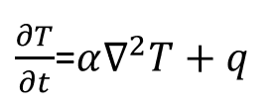
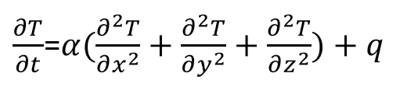
Space AND Time?
The heat equation, which gives us the distribution of temperature throughout a continuous body, has a spatially varying and temporally varying component:
This is going to be a bit of a challenge to model! We will need to adopt a slightly more complicated method than our 1D Poisson matrix from last week.

Slide 11
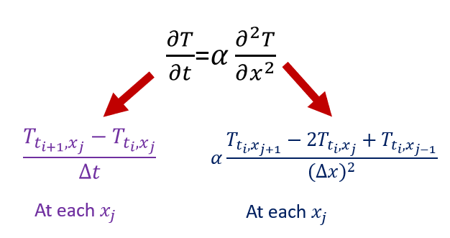
The strategy:
We are very fortunate that time only goes forwards. This means that we can develop an iterative method that solves for all spatial co-ordinates first (via a tri-diagonal matrix), and then steps forward in time.
We will get two equations: one for moving forward in time, the other for space

Slide 12
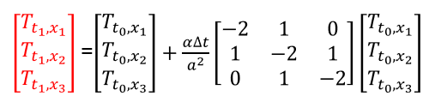

Regular stepping solution Time evoution
It should be noted that this method becomes unstable when $Δt$ becomes too big

Slide 13

It gets better! The Crank-Nicolson method.
Solution? With T(ti), compute both matrixes (front and back), and then:
Combine the back matrix and vector into a single vector
Solve for T(t i+1) as usual.
Note that we’ll be using Linalg.solve again, but the Thomas algorithm is definitely the better way to go.

